Slide 1

Best Neighborhoods of New york city

Slide 2




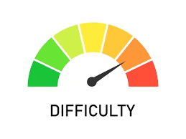
Problem: where to live IN NYC?
Challenging
Difficult
Hard
Impossible

Slide 3

Life of young adults
General
Home Buying Stress (Young Adults): 64% stressed (2023, Apartment List).
Childcare Worries (Young Parents): 72% worried (2023, Child Mind Institute).
Work-Life Balance
Work-Life Balance Importance (Young Adults): 87% (2022, Pew Research Center).
Remote Work Part-Time: 42% (2023, FlexJobs).

Slide 4
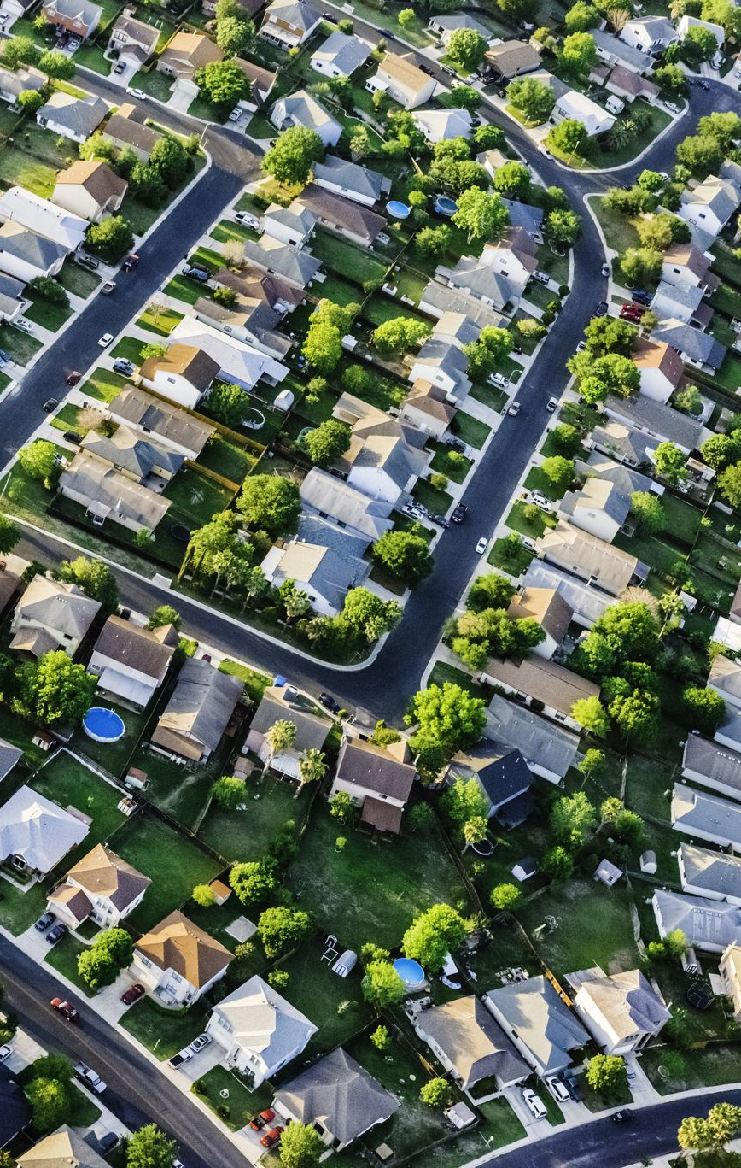
LOCATIOn LOCATION LOCATION
Commuting
Long Commutes (Over 90 Minutes): 4.5% (2023, Census Bureau).
Average Commute Time (NY): 79.6 minutes (2023, Census Bureau).
Median Home Sales Price (NYC): $795,000 (Oct 2023, National Association of Realtors).
Income Spent on Housing: 38% (2022, Pew Research Center).
Housing Costs

Slide 5

Children
Childcare Costs
Annual Childcare Cost per Child: $10,594 (2023, Child Care Aware of America).
Childcare Facilities with Waiting Lists: 80% (2023, Child Care Aware of America).
Education
Student-Teacher Ratio: 17:1 (2020-2021, National Center for Education Statistics).
Students in High-Poverty Schools: 21% (2020-2021, National Center for Education Statistics).

Slide 6

The solution
NYC is a great place to raise a family
Diverse neighborhoods each with unique benefits
Never know if considering all relevant factors when deciding where to live
Unique, easy to use platform where parents can weigh their preferences to find the perfect zip code in NYC for them and their families

Slide 7
Methodology
Source Data
Clean Data
Assign Weights (x3)
Yield a family friendly number score (x3)
Classify into 3 categories
Run models and obtain misclassification rates
Obtain the best misclassification rate
Implement final rankings into Tableau
Use chosen weight method
Scale Data
Assign comprehensive weights
Deliver to client

Slide 8

Data Sets
School Quality
Amenities
Commute Time
Median Income
After School Programs
Noise Complaints
Crimes
Median Rent
Notes:
Arts_and_Entertainment, Community_and_Government Dining_and_Drinkin, Event Health_and_Medicine, Landmarks_and_Outdoors, Retail Sports_and_Recreation
nyc.gov

Slide 9

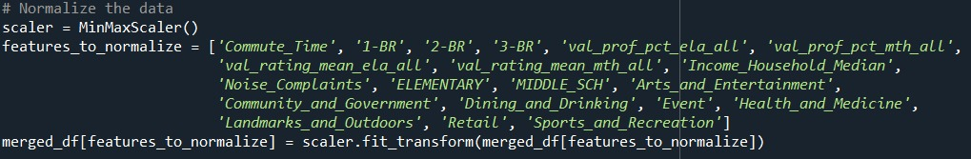
Data Cleansing & Scaling
General Data Cleansing (NAs, Blanks, Misspelling, Etc.)
Aggregating Data by Zip Code
Scaled Data

Slide 10

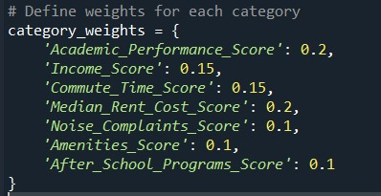
Weight Assigning
"Family Friendliness Score"
1: All Weighted Same
2: Composite
3: Our Own "Arbitrary" Weights

Slide 11
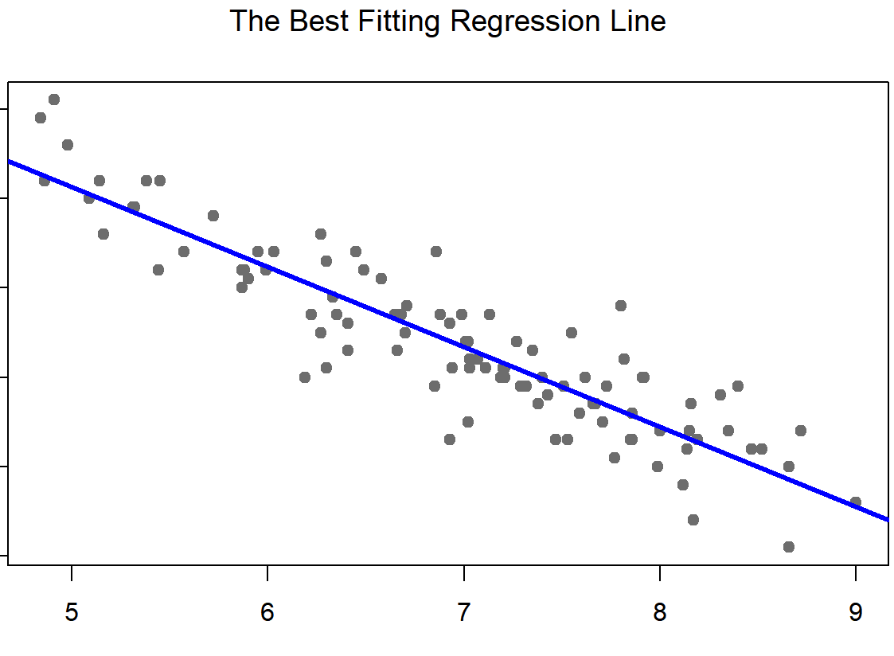
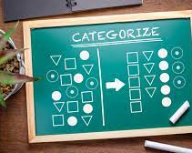
CATORAGIZATION & MODELS​
​
Using Family Friendly Scores, Categorize Each Zip Code (L/M/H)
Find Best Model
Apply Best Weighting Method and Get Rankings
Decision Tree
Models
KNN
Random Forest
SVM
Logistic Regression

Slide 12
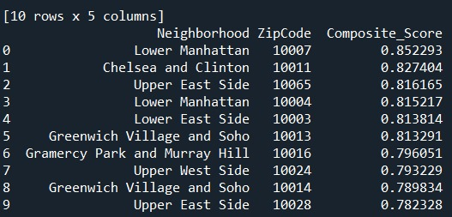
Results

Slide 13
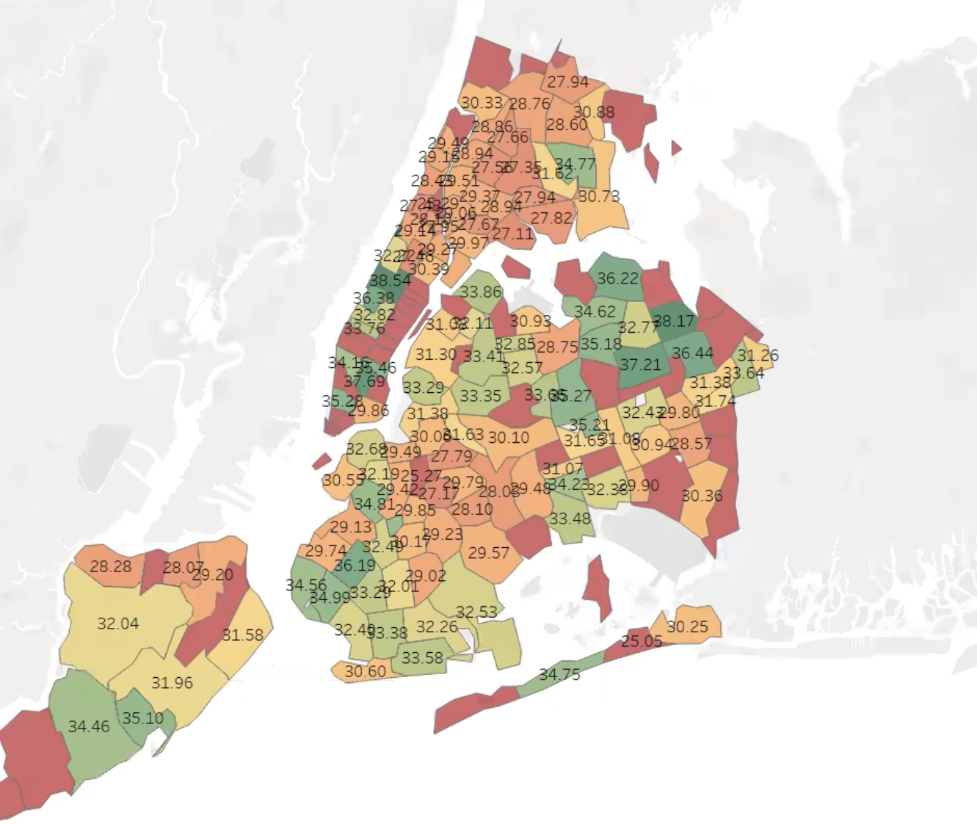
Visualization

Slide 14


A look to the future
Expand to Other Cities
Apply to Different Needs
User-Friendly WebApp

